Slide 1
1.00 Lecture 28 – Random Graphs and Components
John R Williams
Abel Sanchez

Slide 2
Network Models
Networks can be classified by a model of their structure
Mechanistic: Formalize a set of mathematical rules that produce a certain type of network
Often represent notions of cause and effect
e.g. growing a network with preferential attachment
Generative: Generate network structure without the strong causality as in mechanistic models
e.g. random graphs: nodal links are created randomly using prescribed degree distribution

Slide 3
Network Models: Small World
Small-world, or Watts and Strogatz, model
Captures the effect that shortest path between most pairs of nodes in a network is small
Typically just a few steps even in networks of billions
Concept popularized in the expression “six degrees of separation”
Evidenced in the Millgram experiment
Further reading: Easley & Kleinberg, Section 2.3

Slide 4
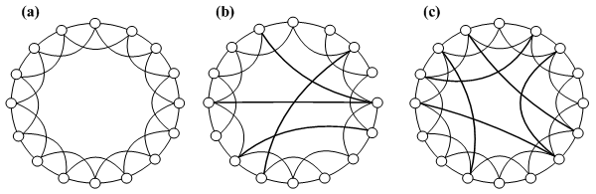
Network Models: Small World
Reducing network diameter, (a) a regular graph in which each node is connected to four neighbors, (b) Watts and Strogatz’s small-world model and (c) Newman an Watt’s improved small-world model

Slide 5
Network Models: Scale-Free
A scale-free network is network whose degree distribution follows a power law
The internet and the World Wide Web are examples of power laws
i.e. only a handful of pages with many links, but millions of pages with only a handful of links
The structure of these networks are similar at all scales
There are parallels with fractals here!

Slide 6
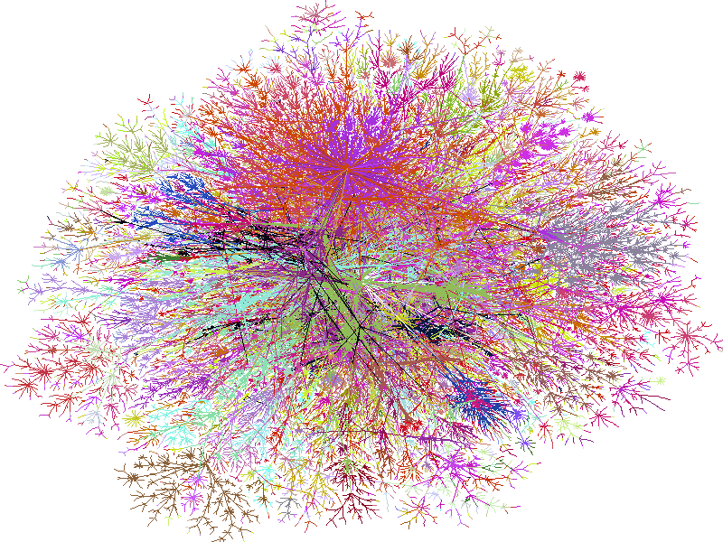
Network Models: Scale-Free
Map of the internet circa 1998, colored by IP address (W.R. Cheswick)

Slide 7
Network Models: Random Graph
Known as the Erdös-Rényi, Poisson, or Binomial random graph
Typically denoted G(n,p) for its two parameters
n = number of nodes in the network
p = probability that a link exists between two nodes
Mathematically very simple – almost everything about its structure can be calculated analytically
Not often representative when compared to real-world networks

Slide 8
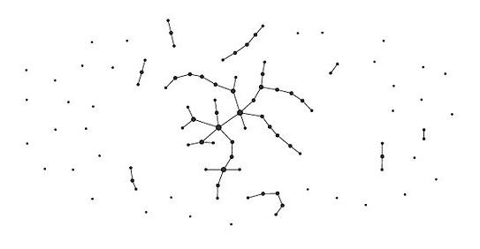
Network Models: Random Graph
Realization of a G(100,0.01) random graph
http://en.wikipedia.org/wiki/File:Erdos_generated_network-p0.01.jpg

Slide 9
Some Concepts: Degree
The degree, k, a node is the number of links terminating or originating at it
In weighted networks, this is termed strength
The mean degree, <k>, of a node in a network
The sum of all degrees in a network must be equal to twice the number of links, m. Why?

Slide 10
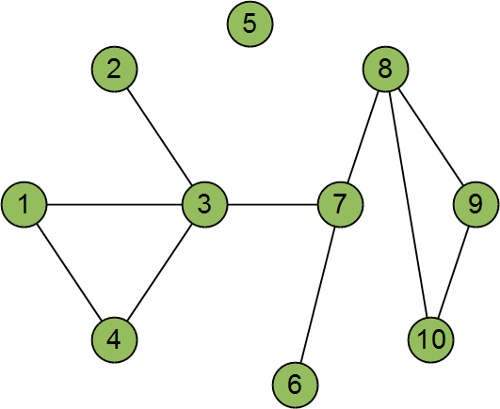
Concepts: Degree Distribution
A defining characteristic of network structure
Define p_{k} to be fraction of nodes in a network that have degree, k
In this example: p₀ = 1/10, p₁ = 2/10, p₂ = 4/10, p₃ = 2/10, p₄ = 1/10
Can you see why?
Can also be thought of as the probability that a chosen node has degree, k

Slide 11
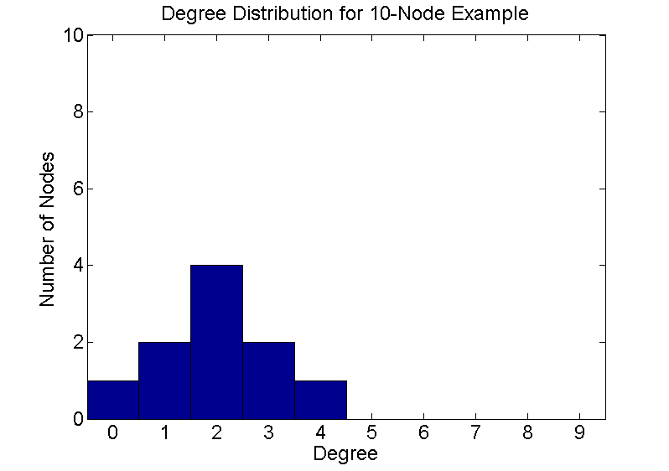
Concepts: Degree Distribution
Extending the probability concept of degree distribution, it can be plotted as a histogram
p = [2 1 4 2 0 1 3 3 2 2];
links = 0:9;
hist(p,links)
set(gca, 'FontSize', 18, 'XLim',[-0.5 9.5], 'YLim', [0 10]);
xlabel('Degree', 'FontSize', 18)
ylabel('Number of Nodes', 'FontSize', 18)
title('Degree Distribution for 10-Node Example', 'FontSize', 18)

Slide 12
Concepts: Degree Sequence
Similar information to degree distribution
The set of degrees, {k₁, k₁, …, k_{n}}, for all nodes
In this example: {2, 1, 4, 2, 0, 1, 3, 3, 2, 2}
Can you see why?

Slide 13
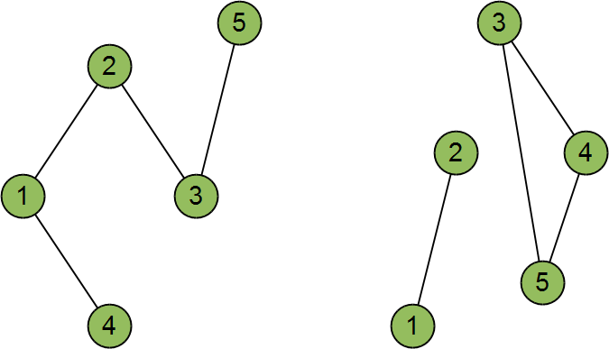
Degree Distribution and Sequence
Neither gives a complete network description
Many realizations for a distribution or sequence
An ensemble represents all possible realizations
In this example: p₁ = 2/5, p₂ = 3/5
Two realizations of the ensemble for the degree distribution [p1 = 2/5, p3 = 3/5]

Slide 14
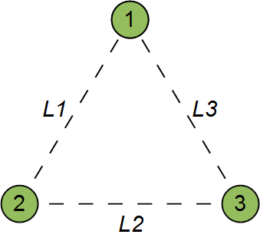
Back to Random Graphs
In a simple, three-node network, suppose that link forms between two nodes with probability, p_{l}
Probability of three links
Probability of two links
Probability of one link
Probability of zeros links
What is the probability of m links on n nodes? What is the probability of a node with degree, k?

Slide 15
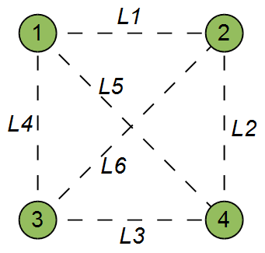
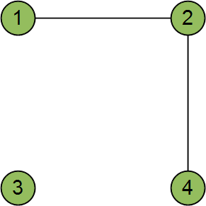
Four-Node Random Graph
There are six possible links in an undirected four-node network
What is the probability that two links are present, but four are not?
e.g. Link 1 and 2 are present
What is the probability of ANY two links existing in this four-node network?

Slide 16
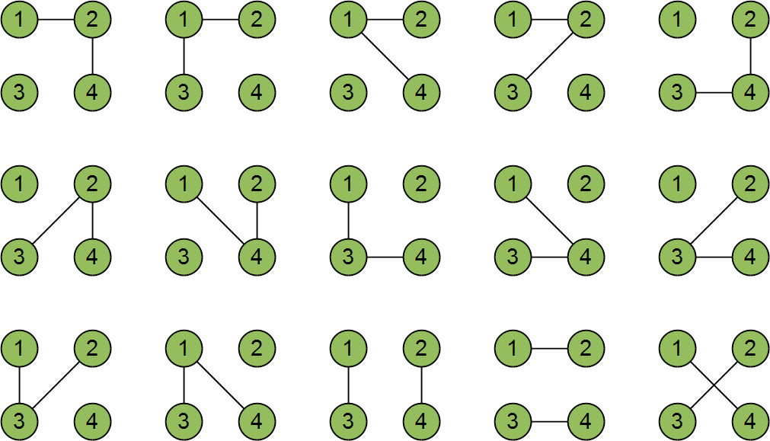
Four-Node Random Graph
Any two links can be formed in 15 ways, below

Slide 17
Four-Node Random Graph
The first link can be chosen in ₄C₂ ways
The second link can be chosen in (₄C₂ - 1) ways
Divide by two to remove duplicates: 6 x 5 / 2 = 15

Slide 18
Generalize to N-Node Graphs
The number of possible links in an n-node graph is t = _{n}C₂
Suppose we want m links in our n-node random network
The first link can be chosen in t ways
The second link can be chosen in (t – 1) ways
The m^{th} link can be chosen in (t – m + 1) ways
Divide by m! to remove duplicate choices

Slide 19
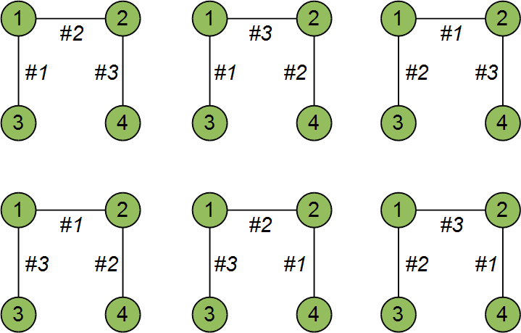
What Are Duplicate Choices?
For example, in our four-node network, the SAME three links could be chosen in six ways
The number of duplicates for m links is m!

Slide 20
Generalize to N-Node Graphs
Putting this together, the total probability of drawing a graph with m links from G(n,p_{l}), in which all p_{l} are independent and equal is:
NOTE: The number of possible links in an n-node graph is t = _{n}C₂

Slide 21
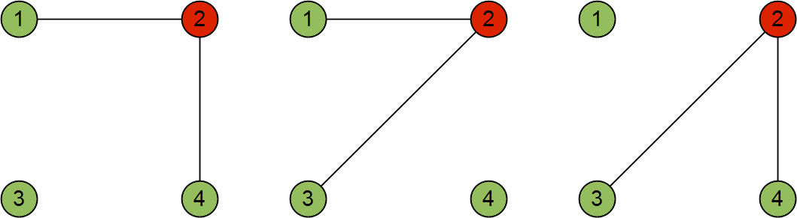
Four-Node Random Graph
It is also possible to infer the probability that a node has a certain degree, k
For a node in this network, there are three ways it can have a degree of two
Choice of nodes to link with is limited to n – 1

Slide 22
Generalize to N-Node Graphs
What is the probability that a node, i, in an n-node random network has k links?
The number of possible links to i is n – 1
For any set of k links to i
The first link can be chosen in (n – 1) ways
The second link can be chosen in (n – 2) ways
The k^{th} link can be chosen in (n – k) ways
Divide by k! to remove duplicate choices

Slide 23
Generalize to N-Node Graphs
Putting this together, the probability of a node having degree k in a random graph, G(n,p_{l}), in which all p_{l} are independent and equal is:
As n becomes very large, and p is small, this is approximately equal to a Poisson distribution
NOTE: In a random network, <k> = p(n – 1)

Slide 24
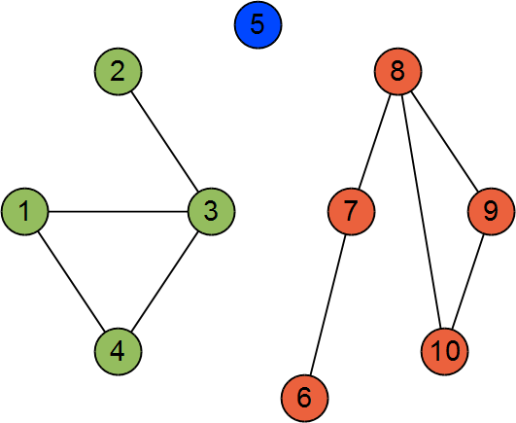
Components
If path between all pairs of nodes does not exist, a network is said to be disconnected
Components are sub-groups of connected nodes
If the entire network is connected, there is only one component
Three components in a disconnected network, colored by their component number

Slide 25
Finding Components
The Breadth-First Search algorithm can be modified to classify nodes into components
Run BFS from every node in the network
BFS will reach all nodes that start node is connected to
Label each node in a single BFS run as being in the same component
Once defined we can run statistics on components e.g. number, size, size distribution

Slide 26
Finding Components: Pseudocode
for i = 1:n
component(i) = -1; % flag each node as unassigned
end
comp = 0; % initialize the component number counter
for i = 1:n
if component(i) < 0 % check that this node not already
% assigned to a component
comp = comp + 1; % increment the component counter
% Run BFS from node i and mark every encountered
% node as a member of the component, comp
end
end

Slide 27
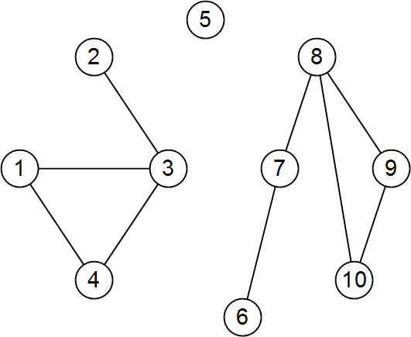
Finding Components: An Example
BFS from node 1

Slide 28
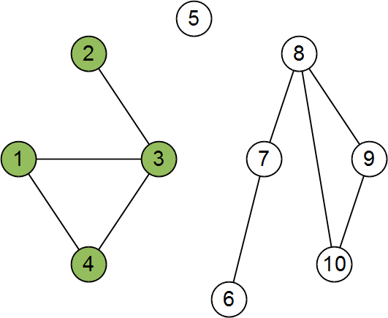
Finding Components: An Example
BFS from node 1
Define component 1
Component 1

Slide 29
Finding Components: An Example
BFS from node 1
Define component 1
BFS from node 2, 3, 4
Already defined
Component 1

Slide 30
Finding Components: An Example
BFS from node 1
Define component 1
BFS from node 2, 3, 4
Already defined
BFS from node 5
Component 1

Slide 31
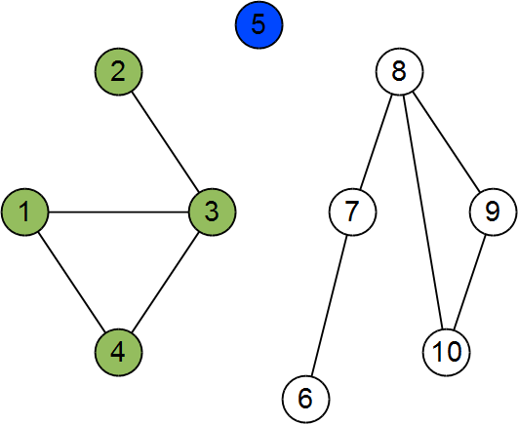
Finding Components: An Example
BFS from node 1
Define component 1
BFS from node 2, 3, 4
Already defined
BFS from node 5
Define component 2
Component 2
Component 1

Slide 32
Finding Components: An Example
BFS from node 1
Define component 1
BFS from node 2, 3, 4
Already defined
BFS from node 5
Define component 2
BFS from node 6
Component 2
Component 1

Slide 33
Finding Components: An Example
BFS from node 1
Define component 1
BFS from node 2, 3, 4
Already defined
BFS from node 5
Define component 2
BFS from node 6
Define component 3
Component 2
Component 1
Component 3

Slide 34
Finding Components: An Example
BFS from node 1
Define component 1
BFS from node 2, 3, 4
Already defined
BFS from node 5
Define component 2
BFS from node 6
Define component 3
BFS from node 7, 8, 9, 10
Component 2
Component 1
Component 3

Slide 35
Finding Components: An Example
BFS from node 1
Define component 1
BFS from node 2, 3, 4
Already defined
BFS from node 5
Define component 2
BFS from node 6
Define component 3
BFS from node 7, 8, 9, 10
Already defined
Component 2
Component 1
Component 3

